Slide 1
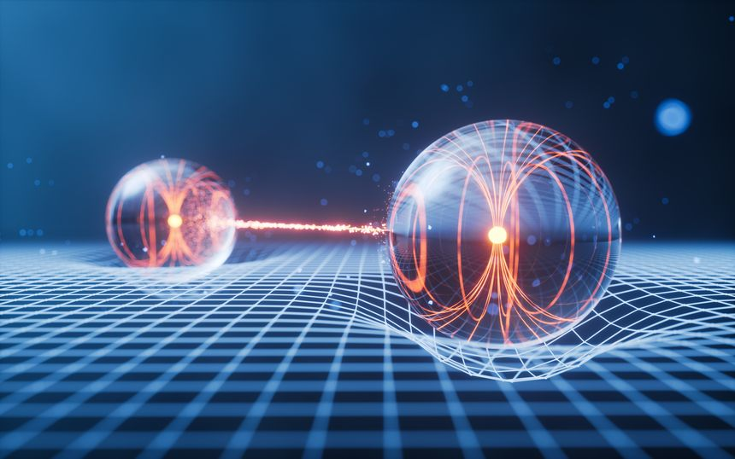
Quantum Feature Refraction: Can Variational Quantum Circuits Enhance Classical Features and Leverage NISQ-Era Noise As Regularization?
By Chris Clark for PHYS 5678 Final Project Fall 2025

Slide 2
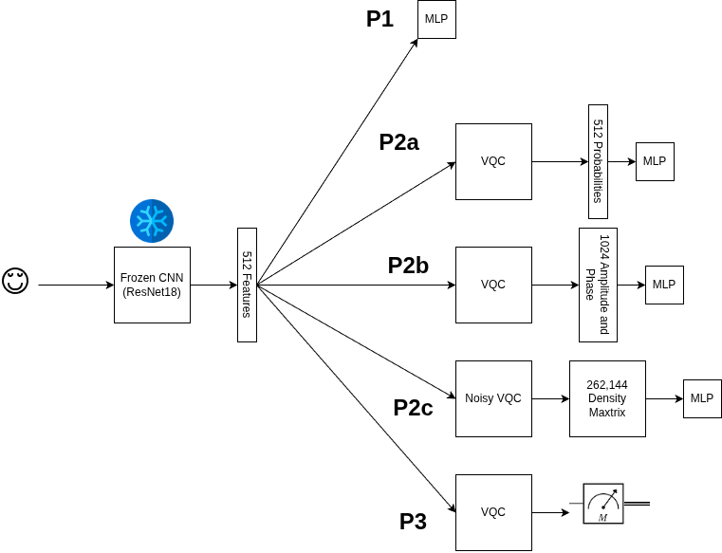
Overall Experimental Setup
Pipeline 1: Standard deep learning pipeline. Image goes into a frozen CNN (ResNet50) and then the output features are fed into the MLP classifier head.
Pipeline 2a: Takes those features and passes them to a VQC, extracts the probabilities from the VQC, then and passes those to the MLP classifier head.
Pipeline 2b: Same as 2a but extracts the full set of complex numbers (i.e., the full quantum state) and passes them to the MLP classifier.
Pipeline 2c: Same as 2a but now with noise, bit flip, amplitude damping, and depolarization. Now, the density matrix, a 512-by-512 matrix, is passed to the MLP classifier.
Pipeline 3: Direct measurement of the first qubit to determine the class from the VQC (no extra classifier head).
We are focusing on binary classification.

Slide 3


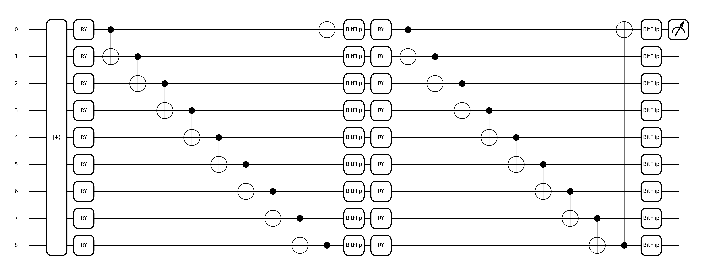
The Variational Quantum Circuit
The variational quantum circuit is a quantum circuit with parameterized gates that can be updated with standard machine-learning optimizers (e.g., gradient descent). We opted for a very simple one for this set of experiments consisting of amplitude encoding:
followed by: for parametrization and CNOT gates for entangling.
We used two layers, as seen in the graphic below with noise added at the end of each layer for each qubit.

Slide 4
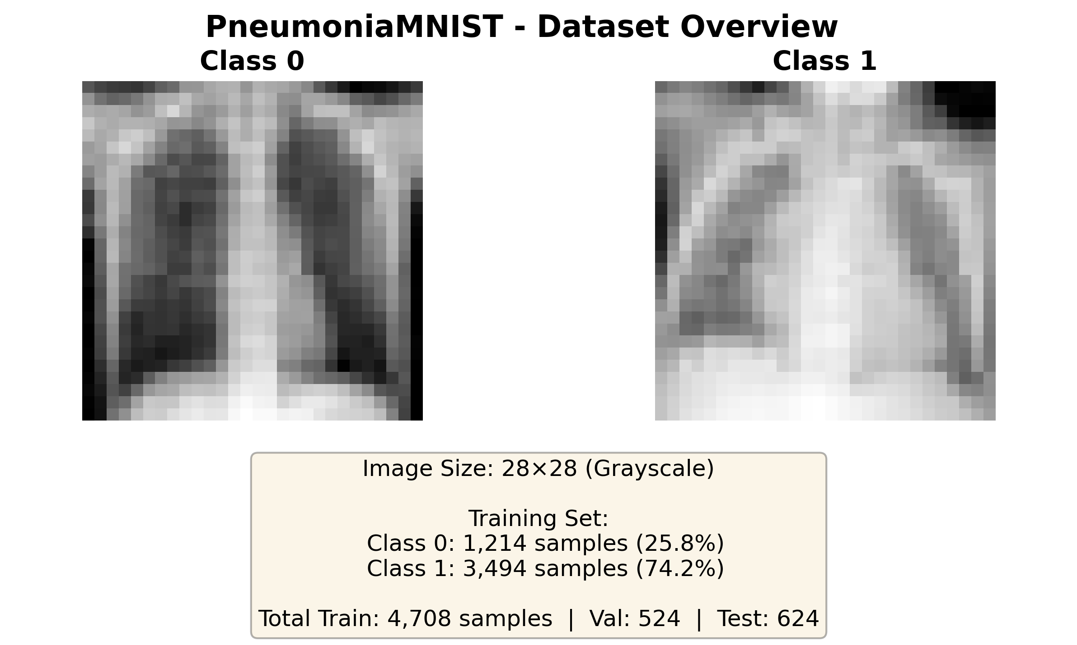
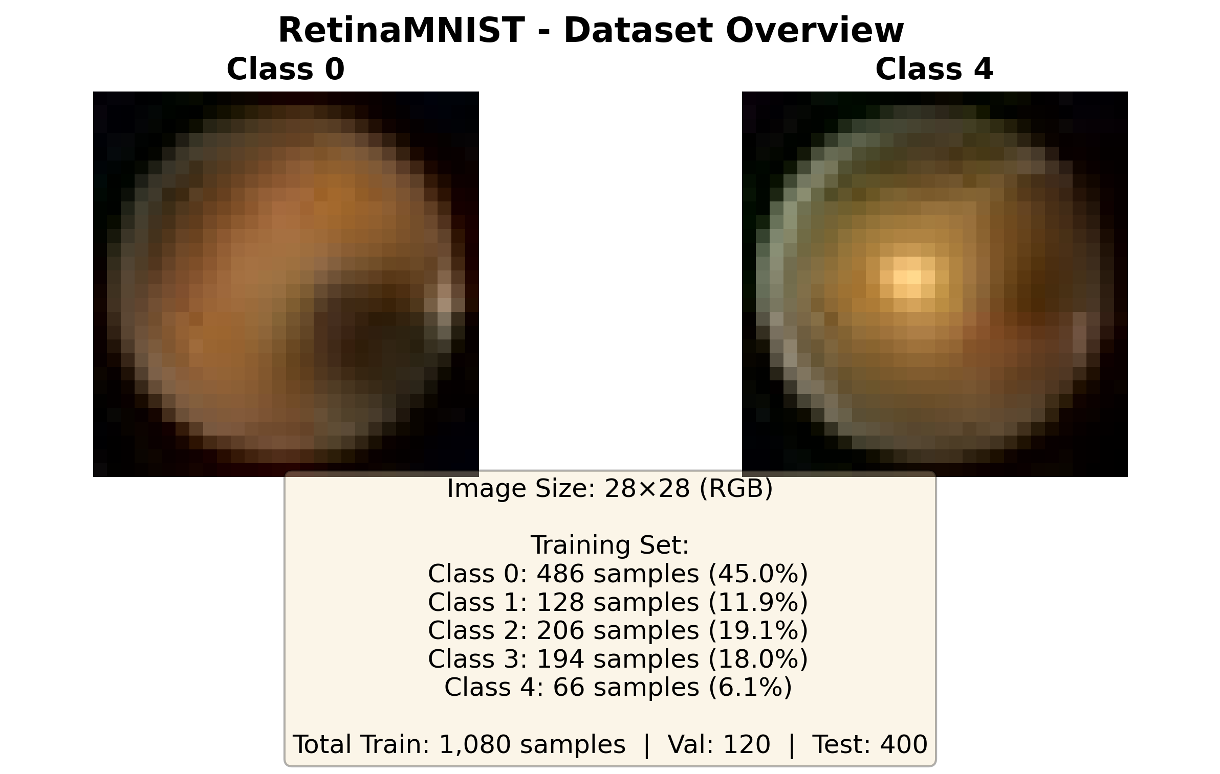
Datasets
The datasets are RetinaMNIST and PneumoniaMNIST, two curated datasets from MedMNIST. For the RetinaMNIST, we combine class 3 and 4 to create class 0. We also use custom data loading to ensure even splits. Shown below are the official dataset splits from the repo.

Slide 5
Experimental Setup and Comparisons
The dropout probability ranges from p=0.0, 0.1, 0.2, 0.3, 0.4, 0.5, to 0.9. The quantum noise probability ranges from p=0.01, 0.03, 0.05, 0.1, 0.2, to 0.3 for each kind. Importantly, we found we had to use dual learning rates of 0.1 for VQC and 0.001 for MLP. We run each 10 times for statistical significance. We also resize the images to 256-by-256.
Tests/Comparisons:
1. Comparison of P1 and P3, classical and quantum classifiers with no noise. This is to simulate a perfectly noiseless quantum classifier and serves as a baseline performance.
2. Comparison of the best of P1 and P3, the classical and quantum classifiers with noise and dropout. This is to determine the role that noise and dropout act as regularizers.
3. Comparison of P2a and P2b, extracting either the probabilities or the full state (real and imaginary parts) from the VQC and passing this to a classical MLP classifier. This is to determine the effect that the phase information has on classifier performance.
4. Comparison of P2c models, noisy VQCs passing their full density matrix to the classical MLP classifier.
5. Comparison of the best of any quantum-based model and the best classical. This is to determine the overall benefit of using a VQC as the classifier itself (as in P3) or as additional feature extraction (P2a/b/c).

Slide 6
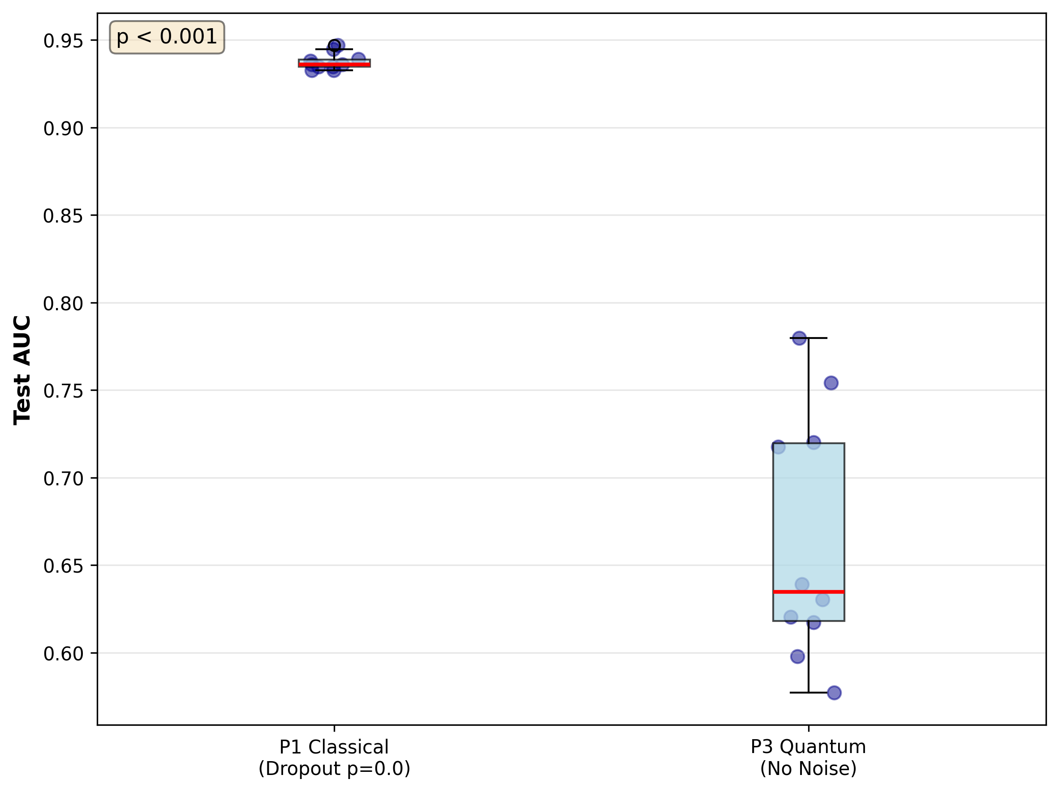
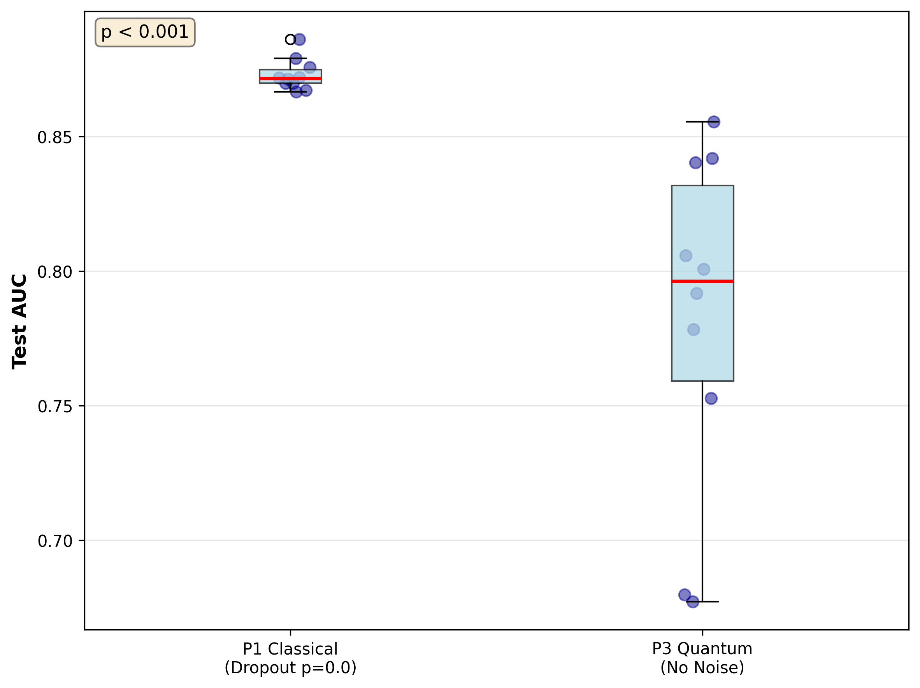
Comparison of P1 and P3, classical and quantum classifiers with no noise

Slide 7
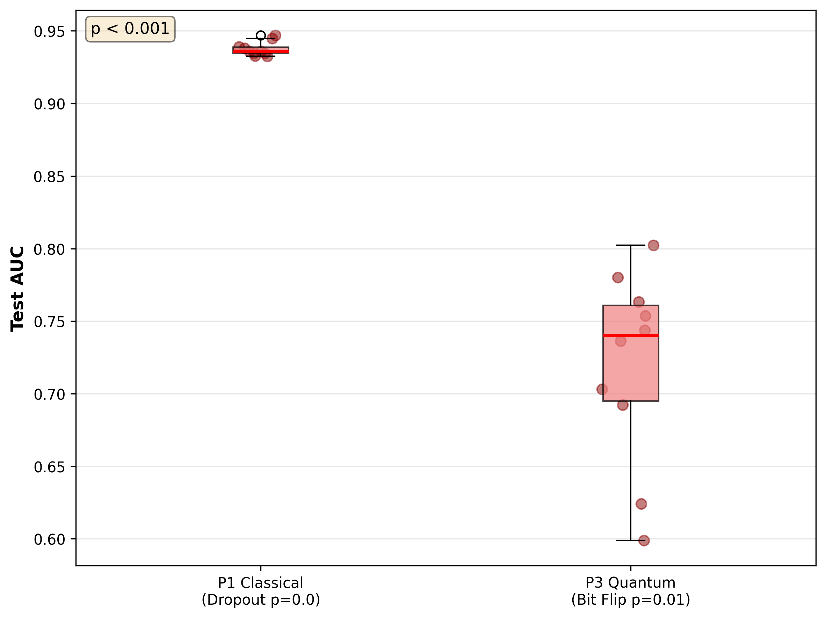
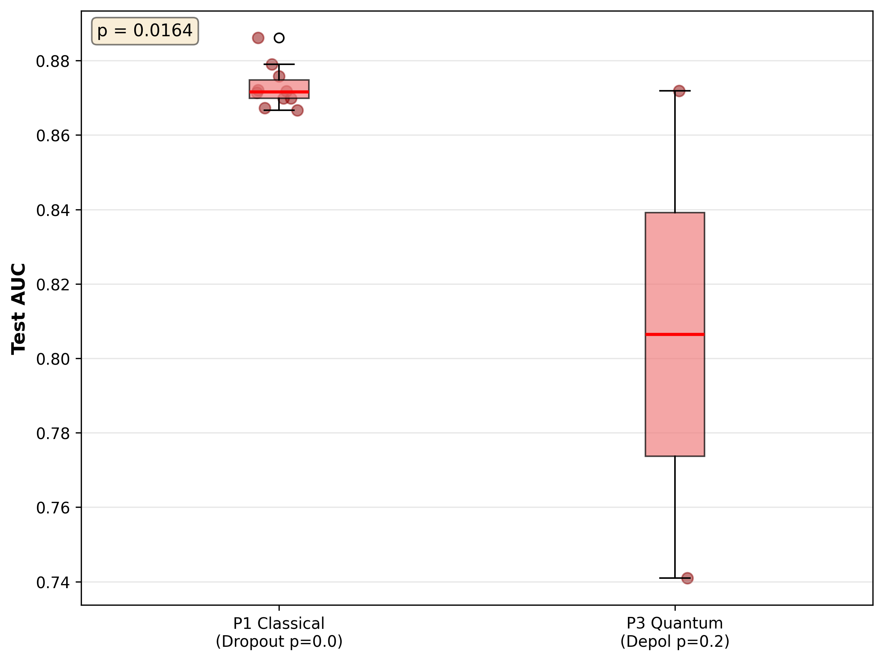
Comparison of the best of P1 and P3, the classical and quantum classifiers with noise and dropout.

Slide 8
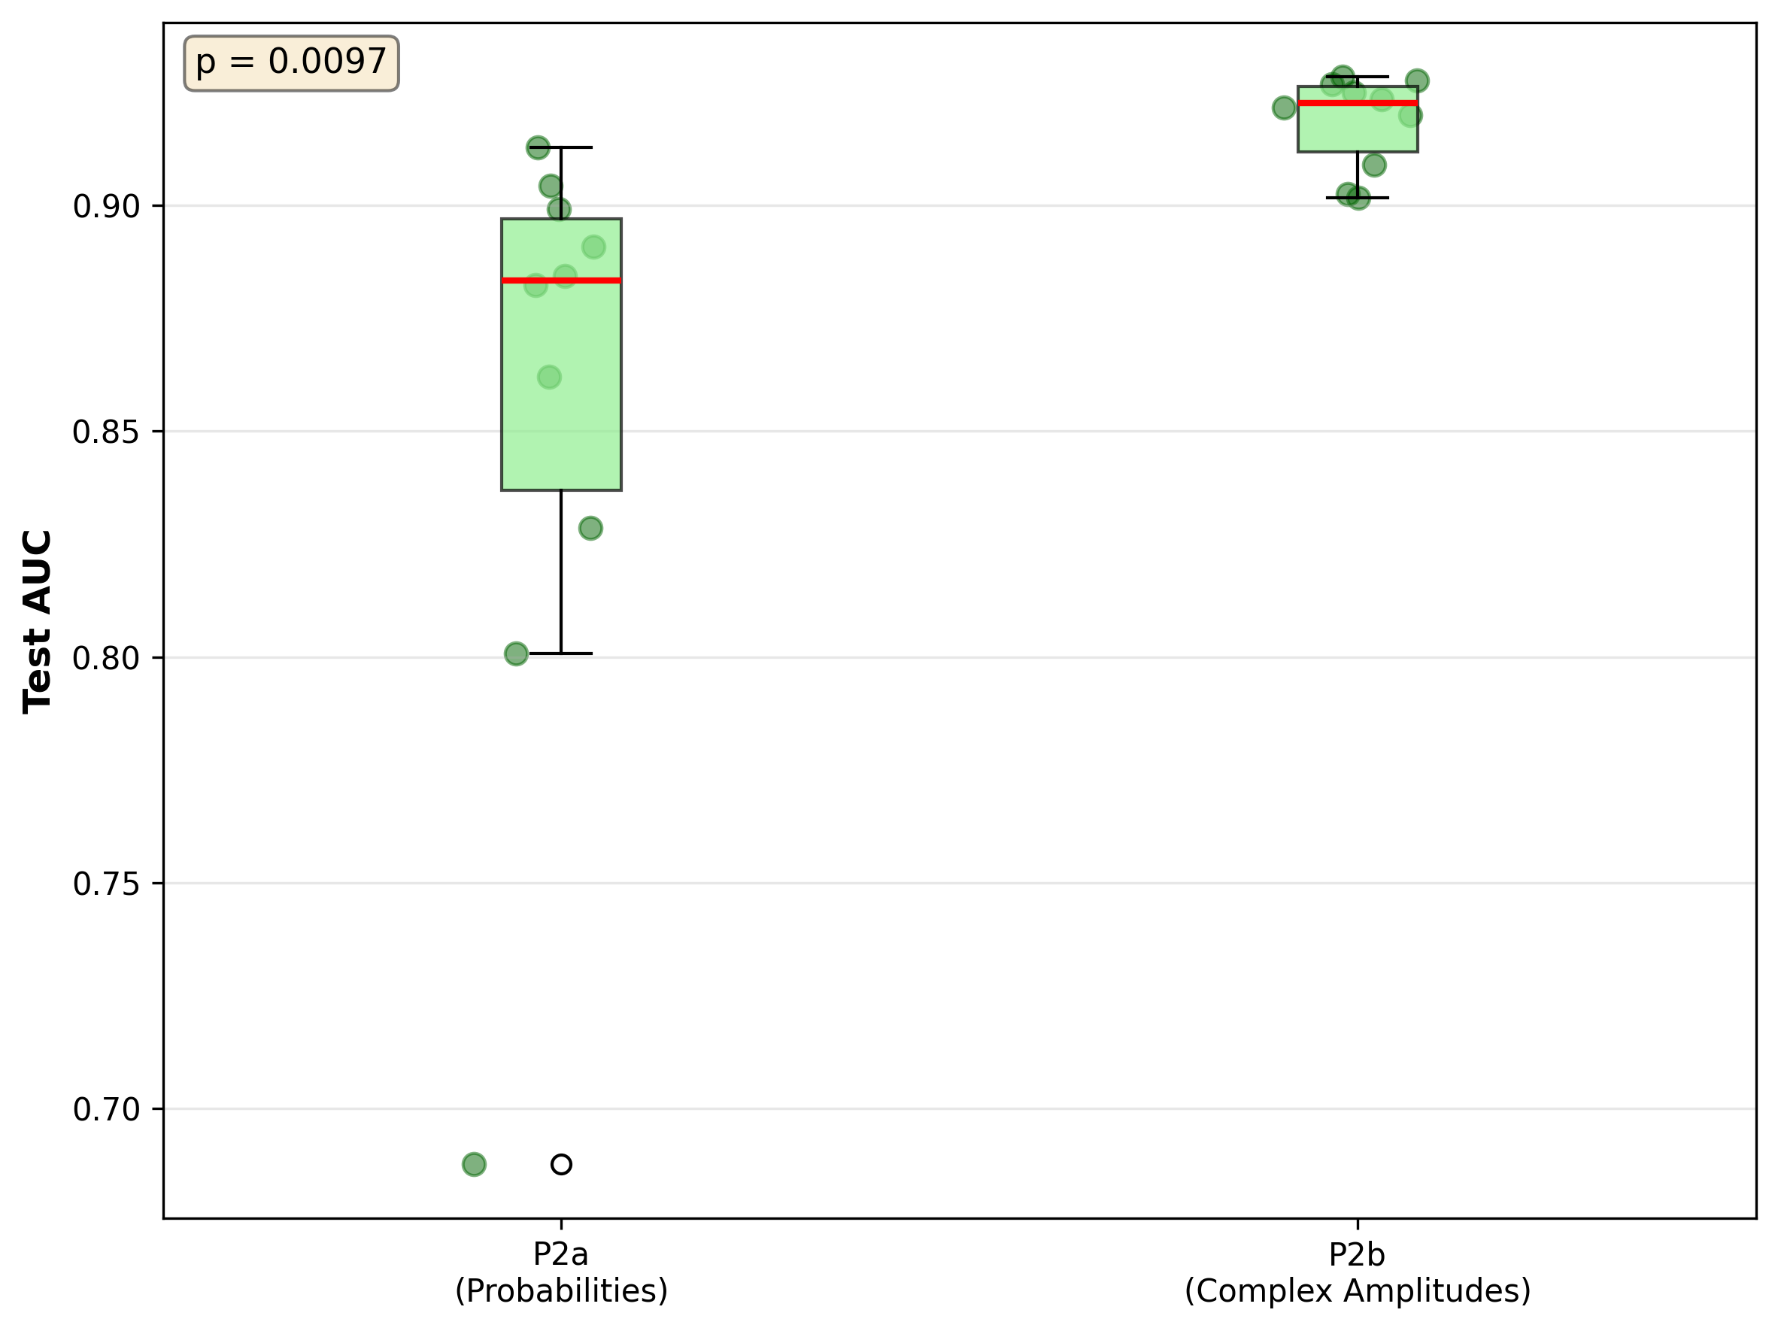
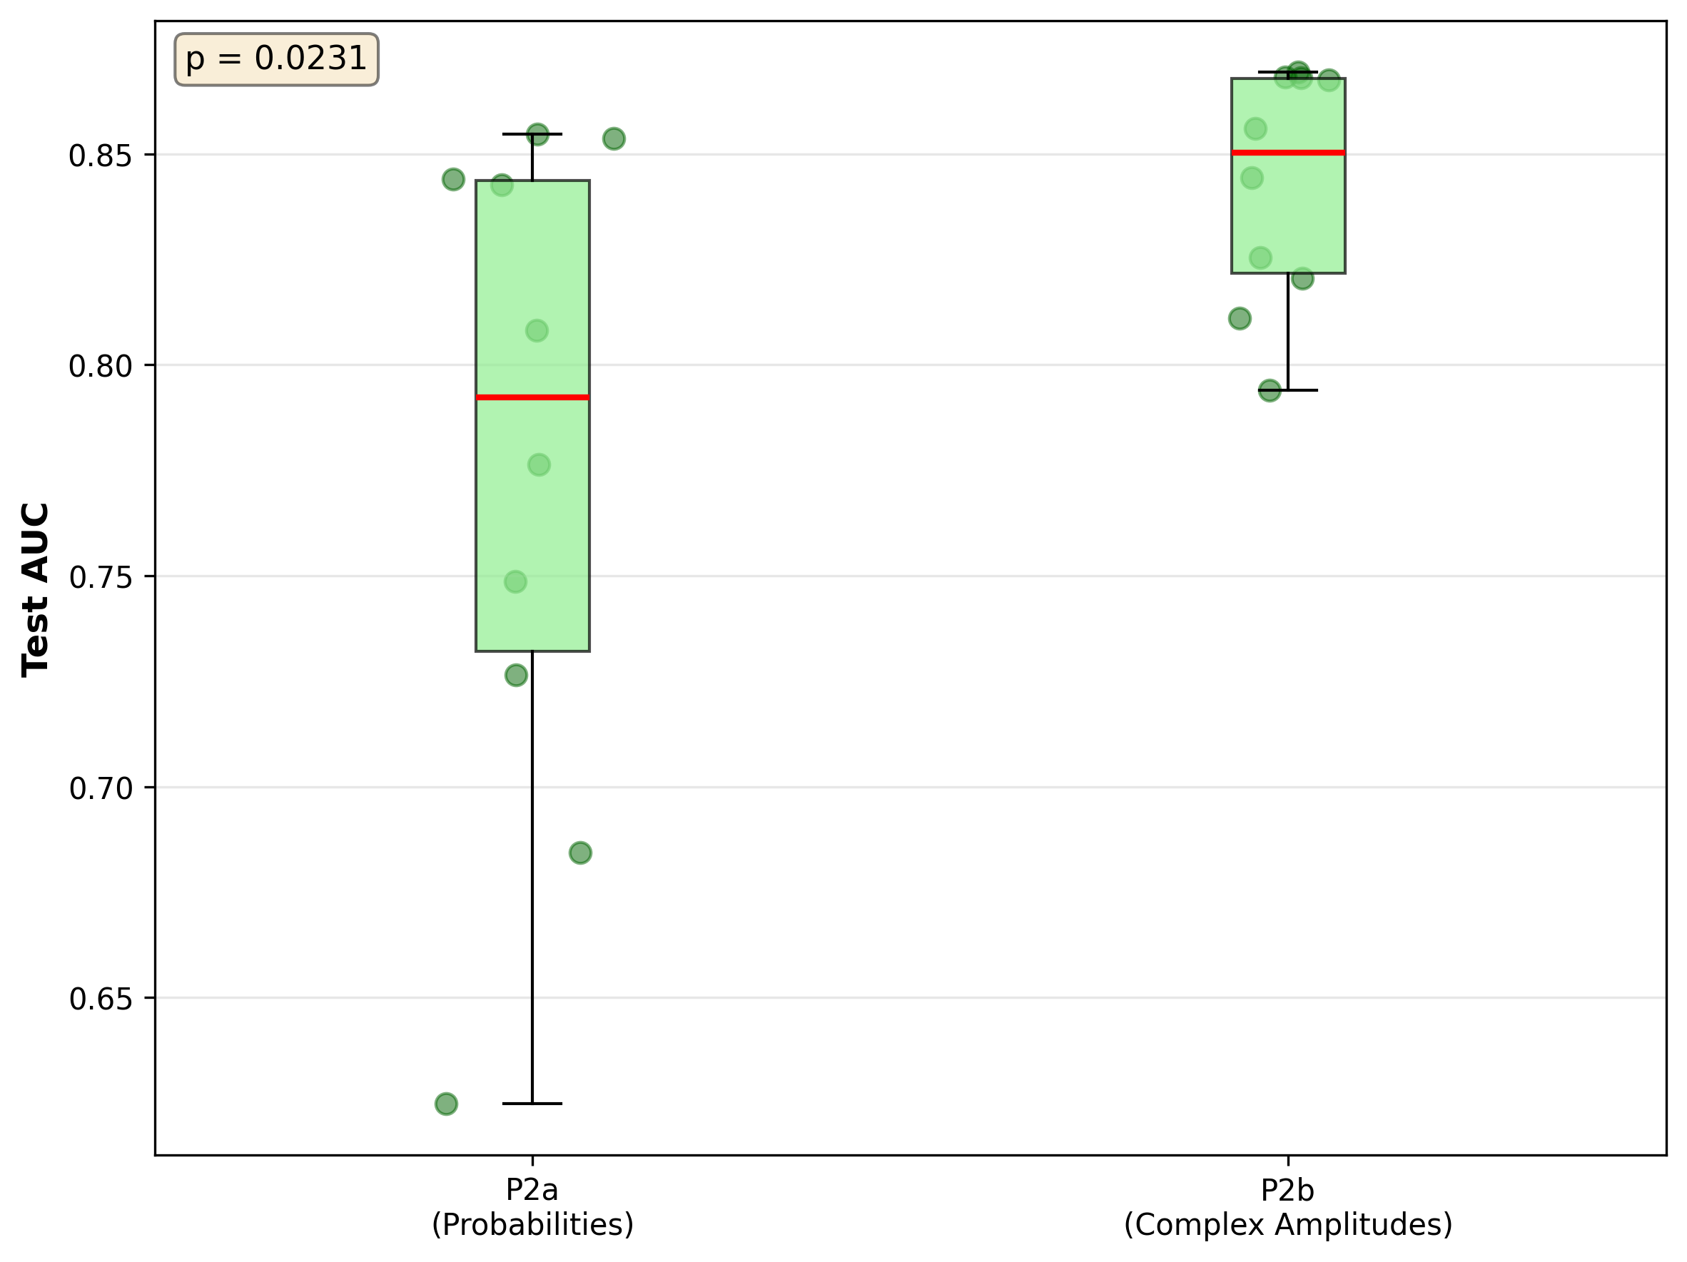
Comparison of P2a and P2b, extracting either the probabilities or the full state (real and imaginary parts) from the VQC and passing this to a classical MLP classifier.

Slide 9
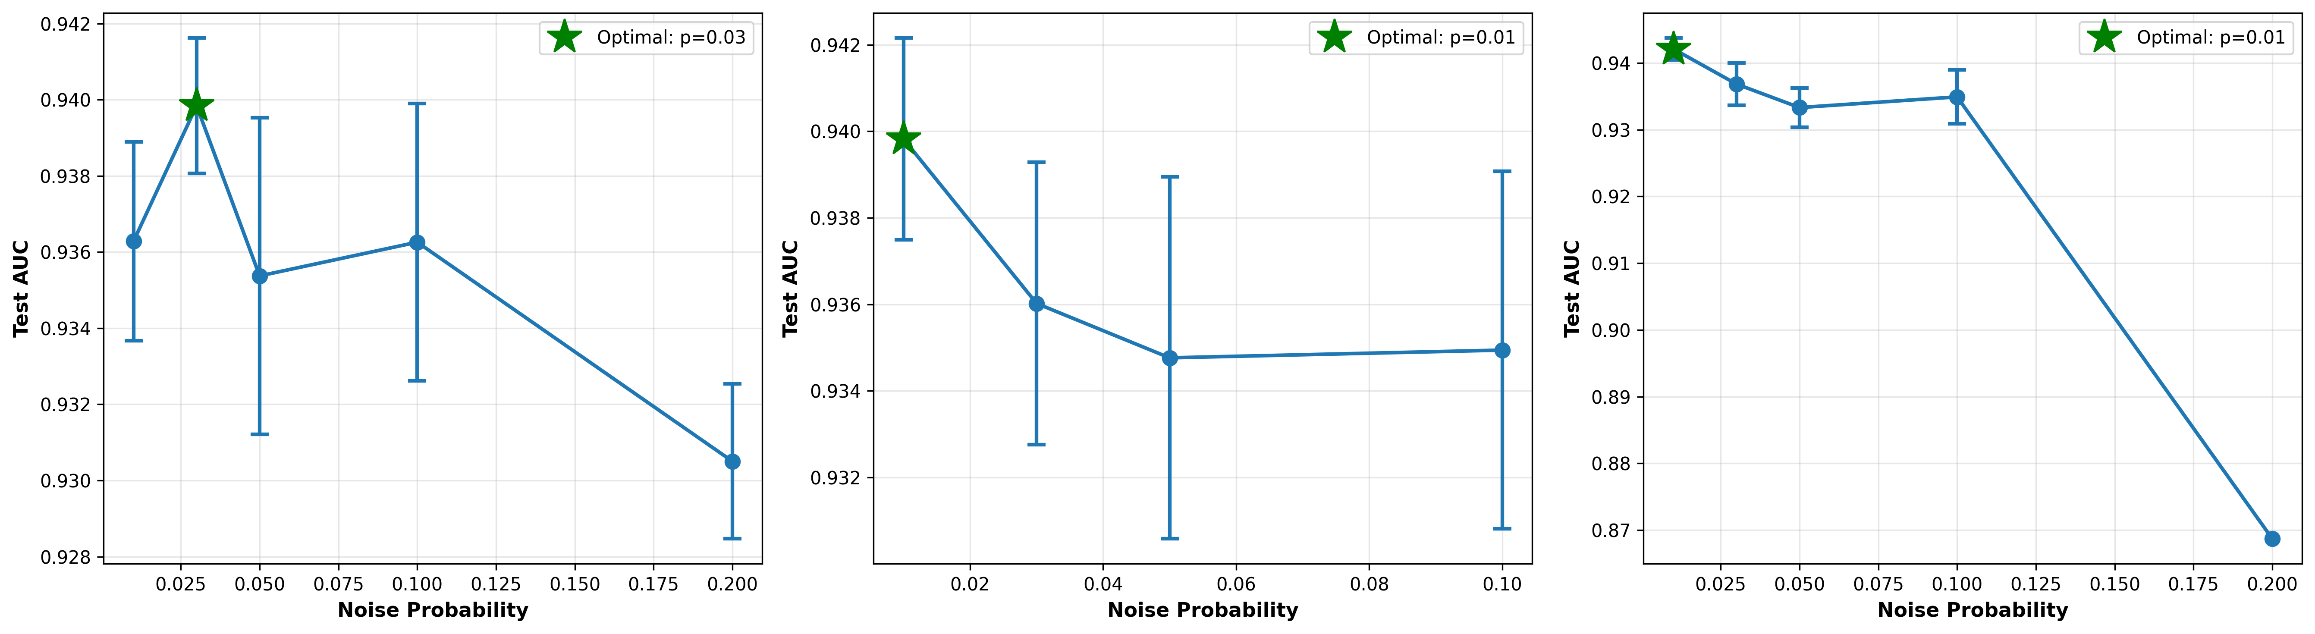
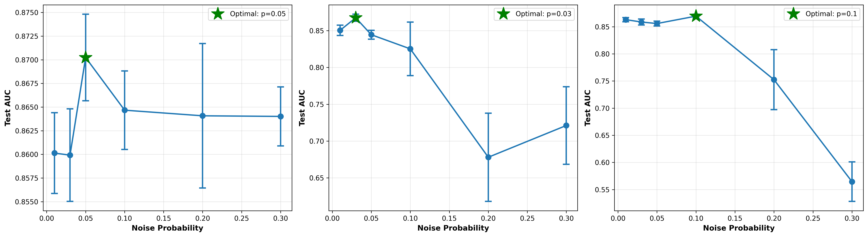
Comparison of P2c models, noisy VQCs passing their full density matrix to the classical MLP. A/B/D

Slide 10
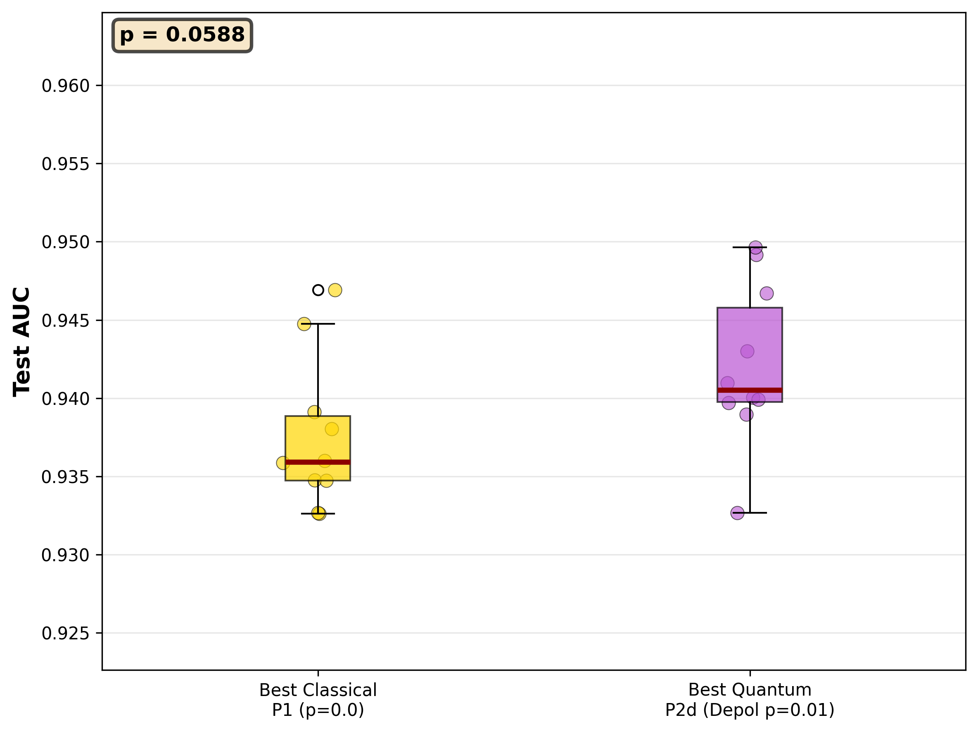
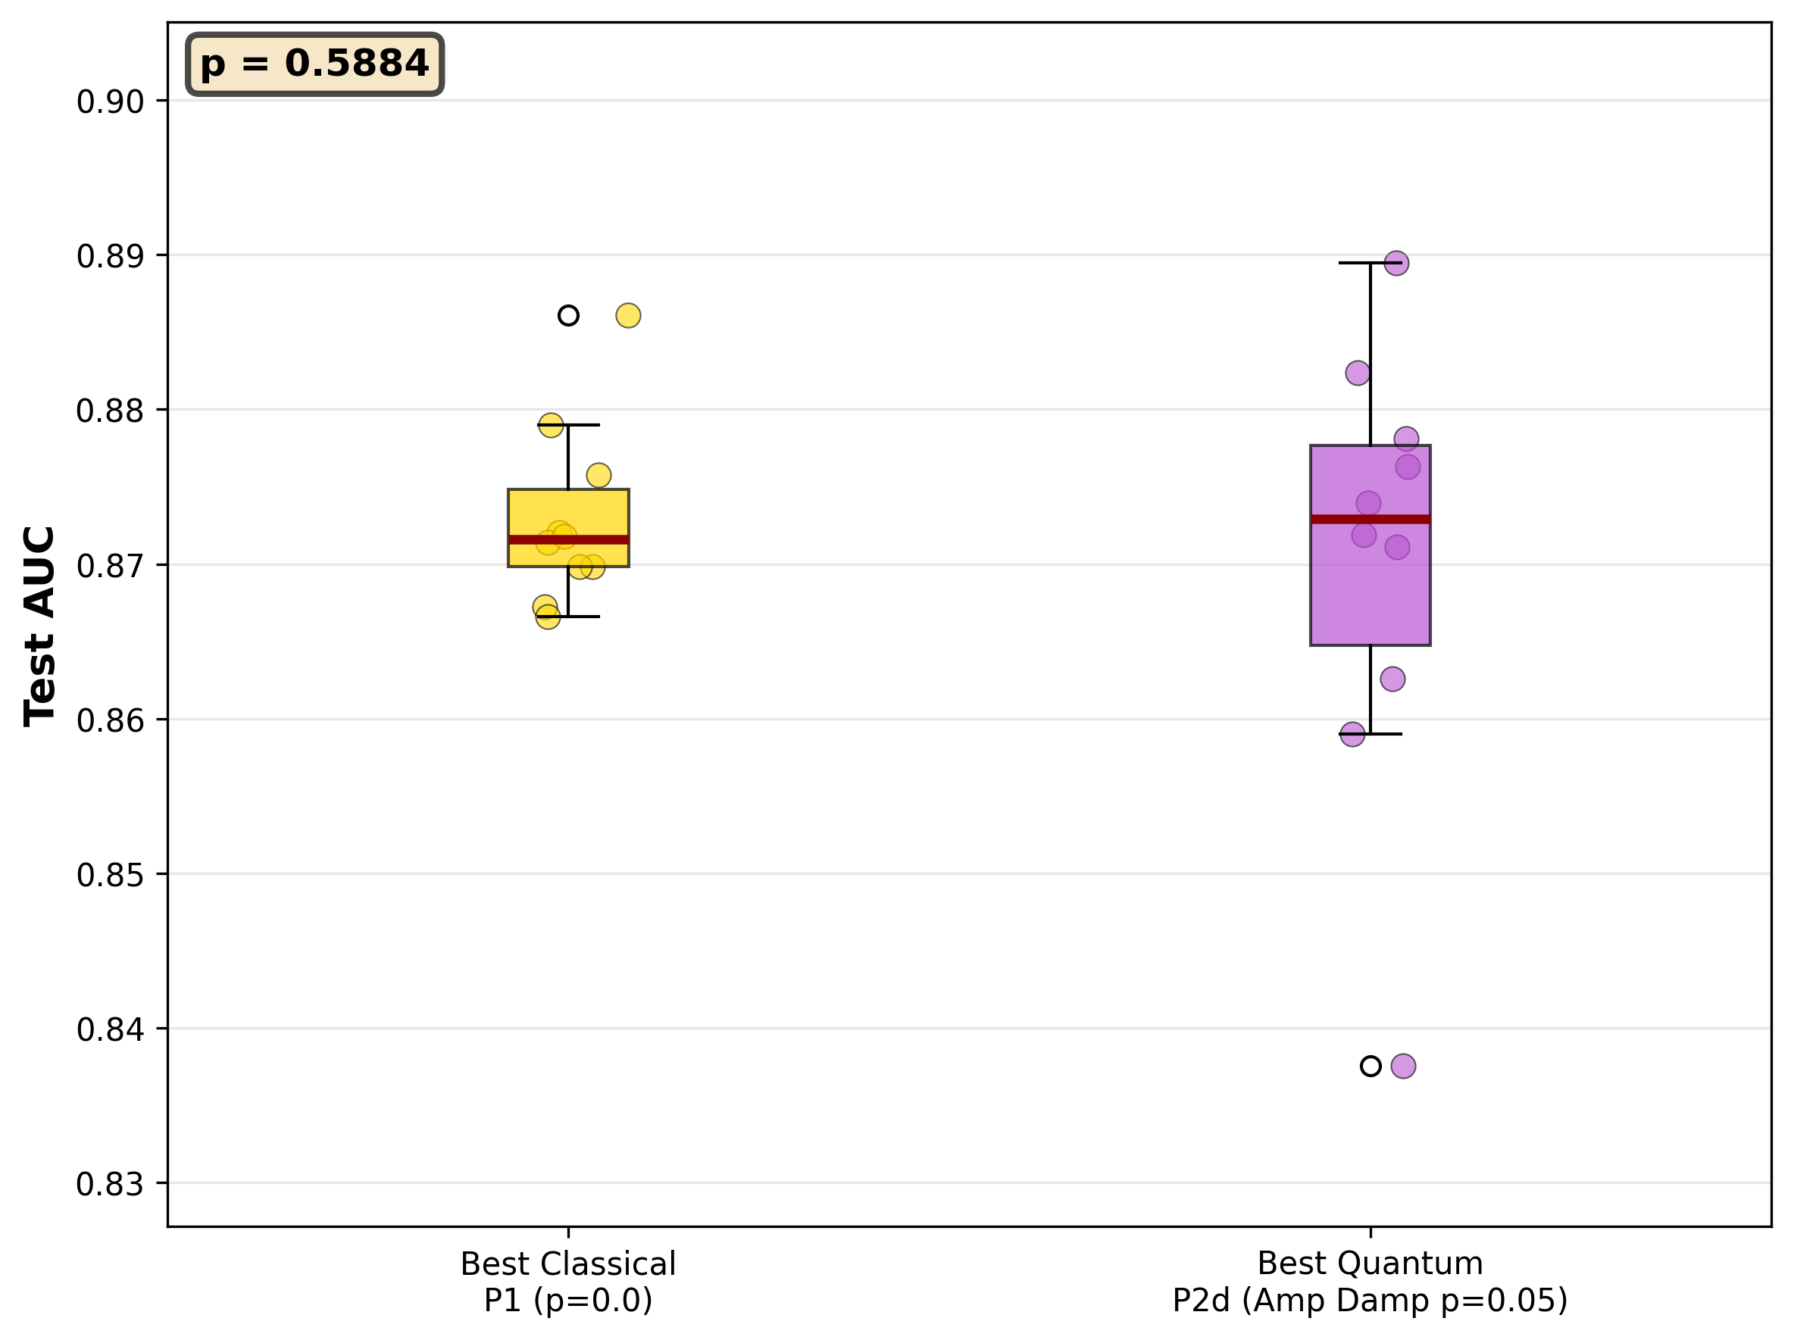
Comparison of the best of any quantum-based model and the best classical.

Slide 11
Results Summary
1. Comparison of P1 and P3: Classical and quantum classifiers with no noise. We find unequivocally that the classical beats the quantum classifier.
2. Comparison of the best of P1 and P3, the classical and quantum classifiers with noise and dropout: Though we do see an improvement in the quantum classifier with a bit of noise, it is still not enough to make much of a difference.
3. Comparison of P2a and P2b, extracting either the probabilities or the full state from the VQC and passing this to a classical MLP classifier: Unsurprisingly, the full quantum state provides significantly more information to the MLP than the raw probabilities and decreases variance (statistical testing needed here).
4. Comparison of P2c models, noisy VQCs passing their full density matrix to the classical MLP classifier: We see that this method improves performance across the board until the noise becomes too strong.
5. Comparison of the best of any quantum-based model and the best classical: The most important finding shows that the best quantum-enhanced models beat the classical, almost to a statistically significant level.

Slide 12
Take-aways
Overall, these sets of experiments show a few things we expected and a couple of surprises. The classical outpacing the quantum classifier could be explained purely by parameters, as the VQC has very few to extract information from the 512 features it receives compared to the MLP. P2b beating P2a also shouldn’t be too much of a surprise, as we are removing all phase information by extracting only the probabilities. Perhaps the most interesting bits thought are that the full density matrix seems to provide good information for the MLP to use. I actually didn’t expect this outcome, or at least that it would be as good. Further, in both the RetinaMNIST and PneumoniaMNIST, the best quantum-enhanced models are noisy, pointing to the utility of noise as a regularizer. Further, the amount of noise required increased in moving from the harder RetinaMNIST to the PneumoniaMNIST, arguing further that noise provides regularization.

Slide 13
Future Work
As simulations, all this needs to be taken with a grain of salt, but at the very least, these results argue that a trained VQC can act as an additional, effective feature extractor on top of the frozen CNN and that noise does regularize and improve performance, especially as the difficulty of the task increases.
Replicating these results on a real quantum computer is the clear next step, but so is adding an additional dataset(s), moving from binary to multi-class classification, exploring more complicated VQC structures, and working on a non-curated dataset. MedMNIST are medical images, but still quite “nice”, and real, messy data is decidedly not.

